Slide 1
Rational vs. Emotional Well-Being: A European Paradox
Why do rational and emotional well-being diverge, and what role does physical activity play in this?
Daria Guliaieva
Contact: dguliaieva@gmail.com

Slide 2

Motivation
I wanted to explore why emotional happiness doesn’t always match
how people evaluate their lives.
Physical activity was chosen as a simple,
universal factor that might help explain this mismatch.

Slide 3



Metrics and Data Sources
Cantril Ladder (rational well-being)
Respondents rate their life on a 0–10 ladder (“best possible life”).
Source: Our World in Data, which uses the Gallup World Poll - a large-scale, globally standardized survey.
Happiness (emotional well-being)
% of people who report feeling “happy” or “rather happy.”
Source: Our World in Data, which uses the Gallup World Poll - a large-scale, globally standardized survey.
Physical inactivity (activity is calculated from this data)
Share of adults insufficiently active according to WHO physical activity recommendations
Based on self-reported data
Source: World Health Organization

Slide 4
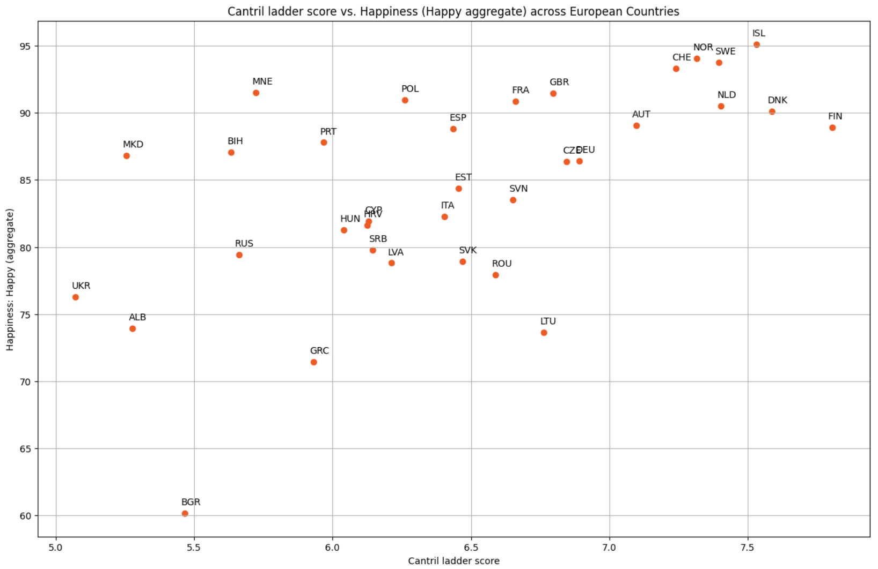
Scatter Plot: Emotional Happiness vs Life Evaluation
There is a correlation, but it is not very strong.
10 countries clearly break the usual pattern:
emotional happiness above 80%,
but life evaluation below the European average of 6.45.
I call these countries the Paradox Countries.

Slide 5

Let's see if physical activity can explain why people in these countries consider themselves happy despite not achieving high levels on the Cantril scale.
To do this, we'll compare their activity levels with the European average.

Slide 6
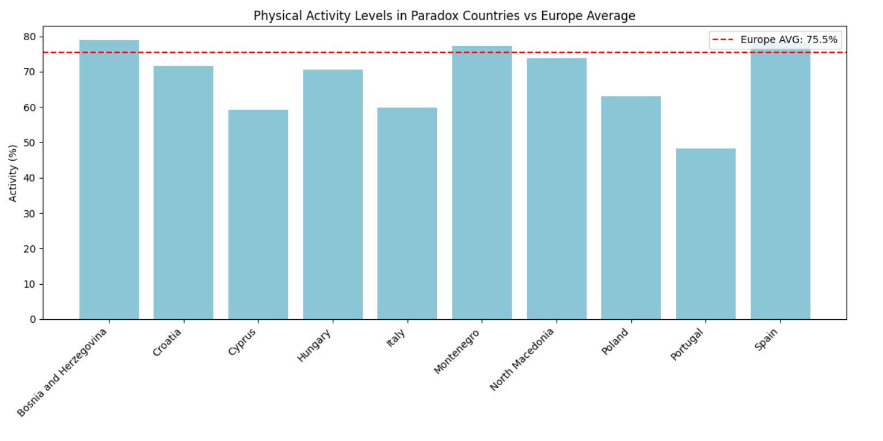
Bar Plot: Physical Activity in Paradox Countries vs Europe Average

Slide 7
Well-Being Leaders
Now let's look at the opposite group — the countries that rank very high on both well-being dimensions.
Top 10 countries by Life Evaluation (Cantril)
Top 10 countries by Emotional Well-Being (Happy %)
Intersection of both groups

Slide 8
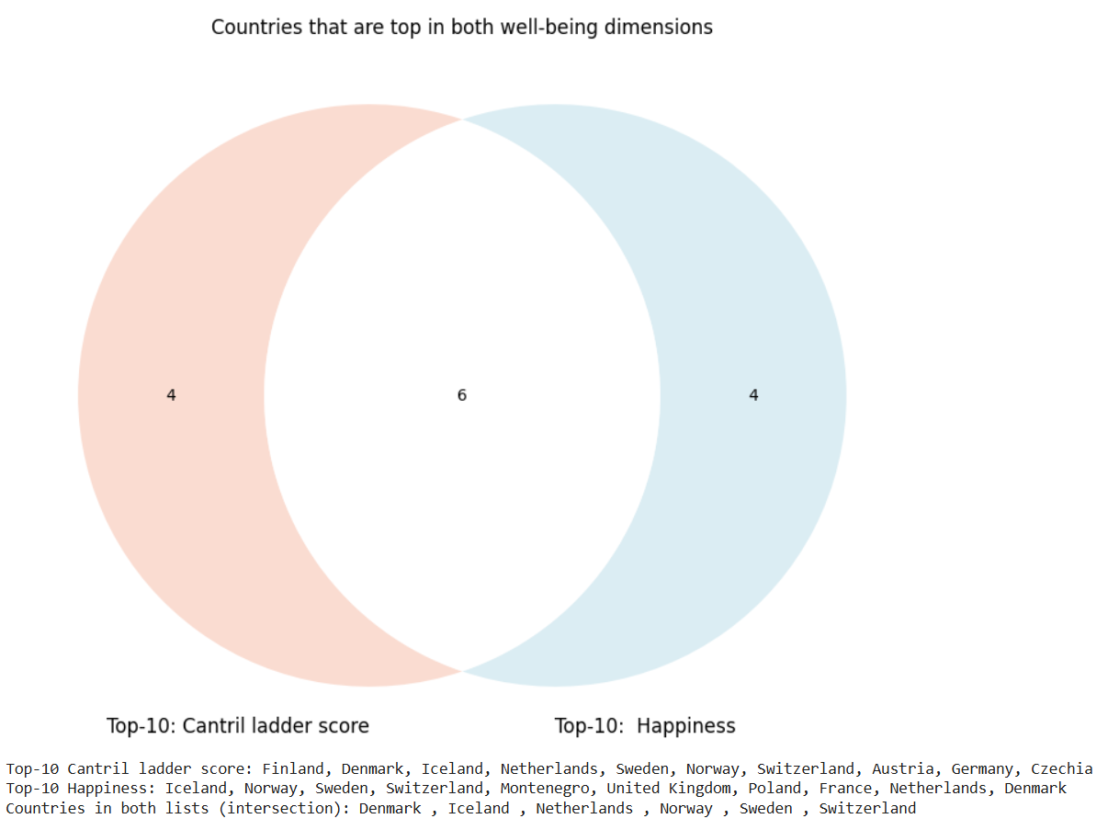
Intersection of Top Countries

Slide 9
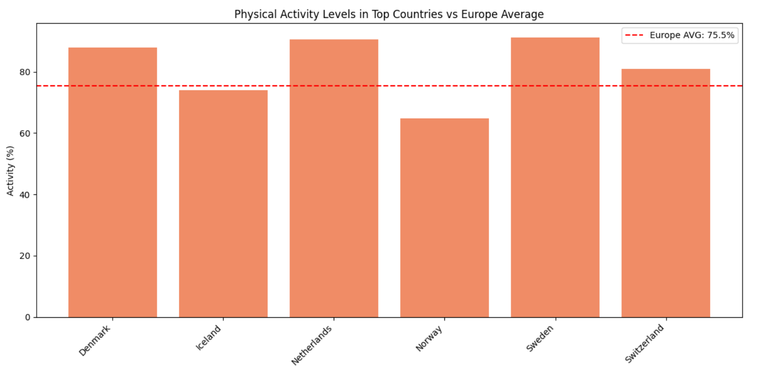
Bar Plot: Physical Activity in Well-Being Leaders vs Europe Average

Slide 10
Conclusion

Slide 11
Physical activity is helpful, but not decisive.
Paradox Countries (high emotions, low life evaluation) seem influenced by:
Cultural differences in how people judge their life
Strong family connections
Warmer climates and lifestyle
Religious values
Well-Being Leaders succeed because of structural factors:
High income and economic stability
Strong social protection
Low corruption
Quality healthcare and education

Slide 12
Future work
Analyze each factor of well-being separately (income, social support, health, freedom, corruption, climate, culture)
Compare their importance for emotional and rational well-being
Check trends over a period of time, not just for one year

Slide 13
Thanks a lot!

